Slide 1
Title | Employee Management App
Course | Cross-Platform Application Development
Presented by | Vishal Sharma
Submitted to | Prof. Chandan R N
Date | 27 Jan 2025
You are one of the best professors we have ever had. Your teaching style is so practical and engaging that there is no doubt any student who attends your class will acquire the skills provided by the course. Note: I did take GPT's help for styling parts, as it has a somewhat steep learning curve for beginners for styling part (I felt). However, I troubleshooted and further improved the styling wherever issues arose.
Demo recording: https://youtu.be/RZABm8SFpk4

Slide 2
Project Overview
Objective: Develop a cross-platform app demonstrating CRUD operations using Back4App as the backend.
Description: A Flutter-based application managing employees with real-time notifications and robust authentication features.

Slide 3

Features BY SCREENS

Slide 4
Authentication Screens
Login Screen (lib/screens/auth/login_screen.dart)
Features:
Allows users to log in using their email and password.
Validates form inputs (e.g., email format and required fields).
Displays error messages for invalid credentials or network issues.
Shows a loading indicator during the login process.
Redirects to the Employee List Screen upon successful login.
Provides navigation to the Signup Screen for new users.
Signup Screen (lib/screens/auth/signup_screen.dart)
Features:
Allows new users to register by providing email, password, and other required details.
Validates form inputs (e.g., email format, password strength).
Displays success or error notifications after registration.
Redirects users to the Login Screen upon successful signup.

Slide 5
2. Employee Management Screens
Employee List Screen (lib/screens/employee/employee_list_screen.dart)
Features:
Displays a list of employees fetched from the backend.
Provides options to add, edit, or delete employees.
Includes a notification badge to display the count of unread notifications.
Allows navigation to the Employee Form Screen for adding or editing employees.
Refreshes the employee list after CRUD operations.
Employee Form Screen (lib/screens/employee/employee_form_screen.dart)
Features:
Allows users to add or edit employee details such as name, email, position, and salary.
Validates form inputs (e.g., required fields, email format, numeric validation for salary).
Displays success or error notifications after saving changes.
Redirects back to the Employee List Screen upon successful submission.

Slide 6
3. Notification System Screens
Notification History Screen (lib/screens/notification/notification_history_screen.dart)
Features:
Displays a list of system notifications with timestamps.
Uses the timeago package to show human-readable timestamps (e.g., "5 minutes ago").
Filters notifications to show only those from the last 24 hours.
Allows users to mark notifications as read or clear old notifications.
Differentiates between read and unread notifications visually.
4. Common Features Across Screens
Error Handling:
Displays error dialogs for network issues or invalid operations.
Loading Indicators:
Shows loading spinners during API calls or data fetching.
Navigation:
Seamless navigation between screens using Flutter's Navigator.

Slide 7
IMPLEMENTATION Perspective & SECURITY CONSIDERATIONS
Key Features
Authentication: Login, signup, and session management.
Employee Management: Full CRUD functionality with validation.
Notifications: Real-time updates with history and filtering.

Slide 8
Authentication Implementation
User Authentication: Handled via Back4App's Parse SDK using ParseUser for login, signup, and logout.
Session Management: Validates session tokens and auto-logout on invalid sessions.
Security: Passwords are securely managed by Parse SDK with HTTPS transmission.
ACL: Setting ACL’s to prevent security vulnerability by allowing right access to app user with invalid sessions by any mean.
Employee Management
CRUD Operations: Employees can be added, edited, deleted, and listed using Back4App's Employee class.
Validation: Form validation for required fields, email format, and numeric salary.
Features: Employee list screen with navigation to add/edit forms. Notifications for CRUD actions.

Slide 9
Notification System
Features: Displays notifications with timestamps, unread/read status, and a 24-hour filter.
Storage: Notifications are persisted using SharedPreferences.
Auto dismiss notifications (in 2 seconds) or user could dismiss by clicking on cross button.
Back4App Models
User Model: Manages authentication with fields like username, password, and email.
Employee Model: Stores employee details (name, email, position, salary) for CRUD operations.

Slide 10

Technology Stack

Slide 11
Technology Stack
Frontend
Flutter: A cross-platform UI toolkit for building natively compiled applications for mobile, web, and desktop from a single codebase.
Dart: The programming language used for Flutter development.
Backend
Back4App: A backend-as-a-service (BaaS) platform built on Parse Server.
Parse SDK: Used for handling authentication, session management, and CRUD operations.
Parse Server Features:
User authentication and session management.
Data storage for employee and notification models.
Built-in security features like HTTPS and session token validation.

Slide 12
State Management
Local State Management: Managed directly within widgets using setState. No external state management libraries like Provider are used.
Storage
SharedPreferences: Used for local storage of notification data and other small key-value pairs.
Packages and Libraries
parse_server_sdk_flutter: For interacting with Back4App's Parse Server.
shared_preferences: For local data persistence.
timeago: For displaying human-readable timestamps (e.g., "5 minutes ago").
crypto: For cryptographic operations (if required).

Slide 13
Development Tools
Visual Studio Code: Recommended IDE for Flutter development.
Flutter CLI: For building, running, and managing the Flutter project.
APIs
Parse API: Used for backend communication, including user authentication, employee data management, and notifications.
Security
HTTPS: Ensures secure communication between the app and Back4App.
Parse SDK Security: Handles password hashing, session token management, and secure data transmission.
This stack ensures a robust, scalable, and secure application with minimal backend management, leveraging Back4App's BaaS capabilities.

Slide 14
Challenges Encountered

Slide 15
Challenges Encountered
Ensuring cross-platform UI consistency.
Styling has a steep learning curve, would be nice if they have followed similar HTML styling standard.

Slide 16
Screenshots / Demo

Slide 17
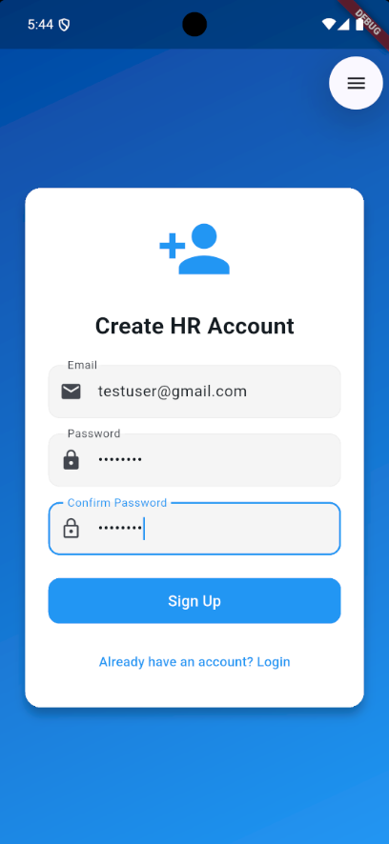
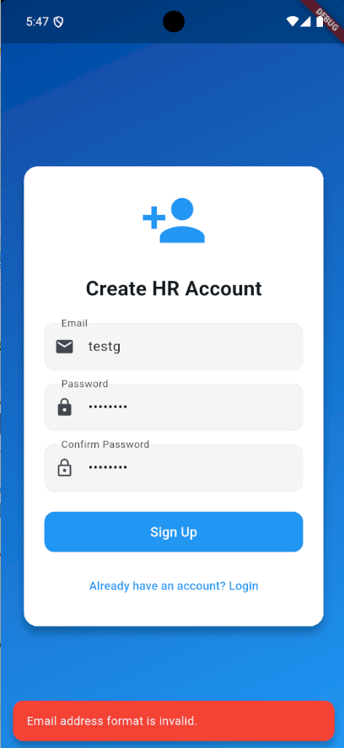
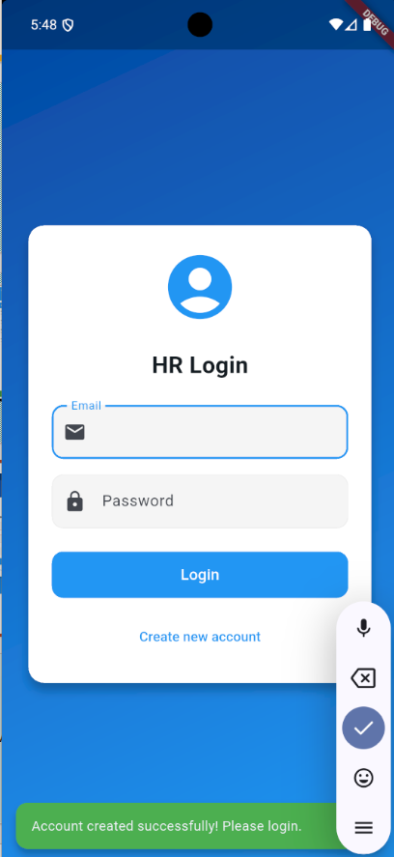
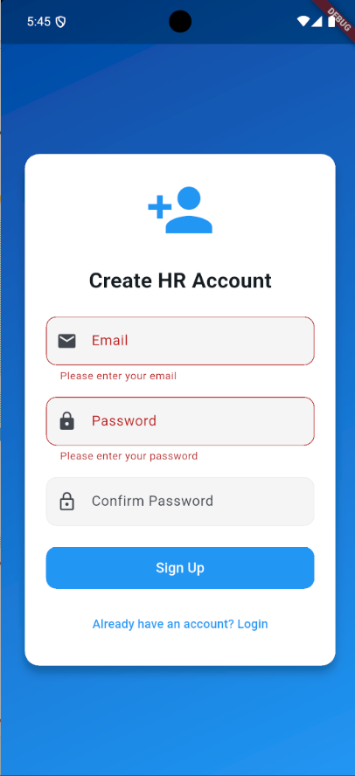

Slide 18
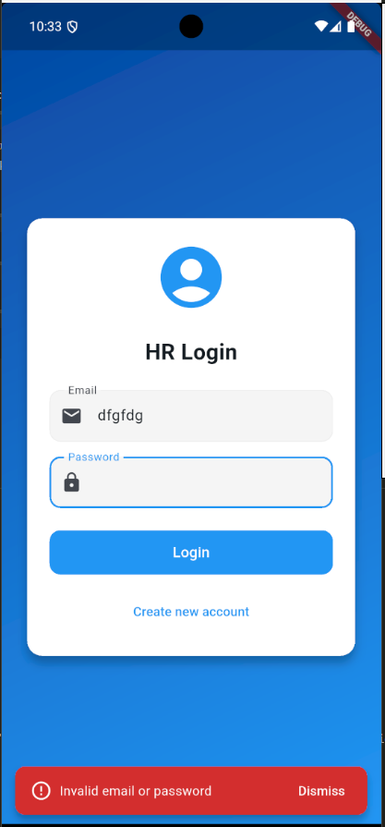
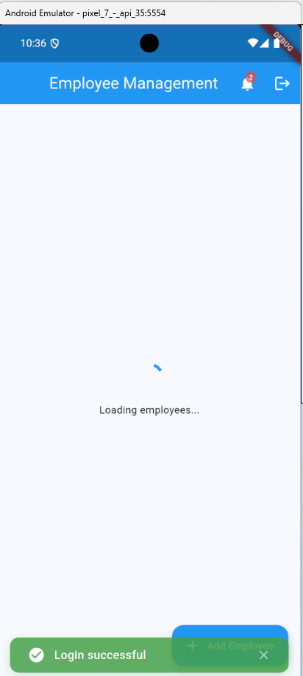
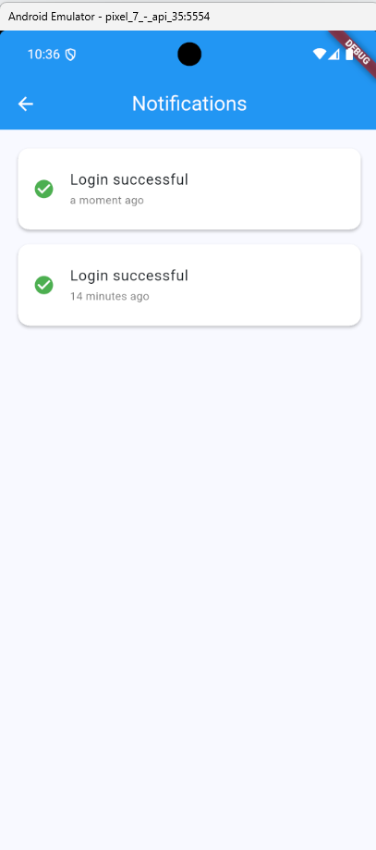
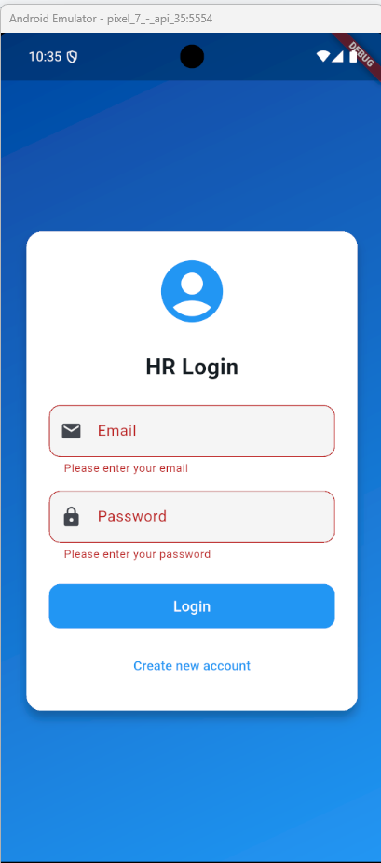
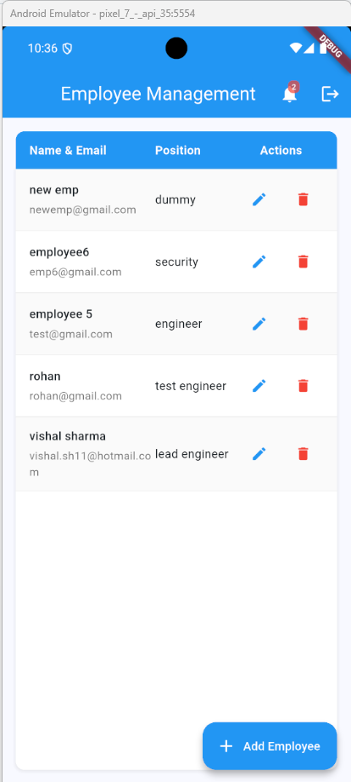

Slide 19
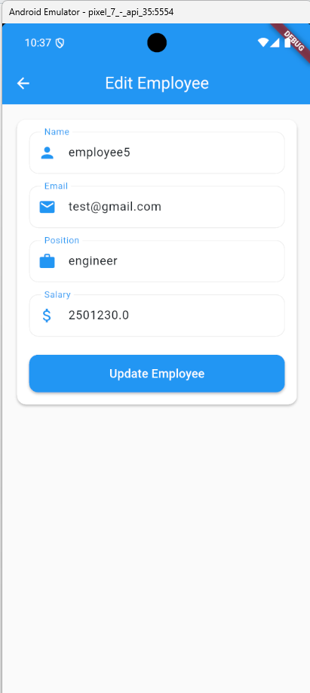
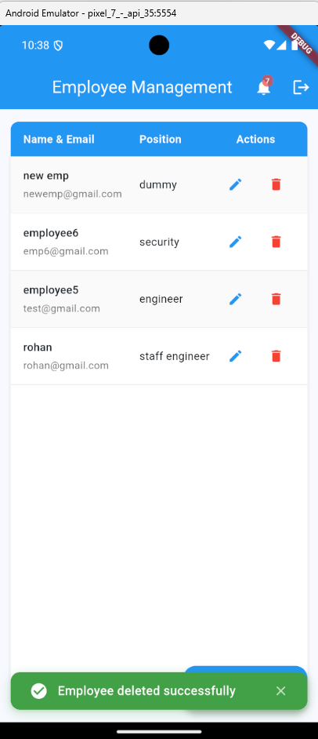
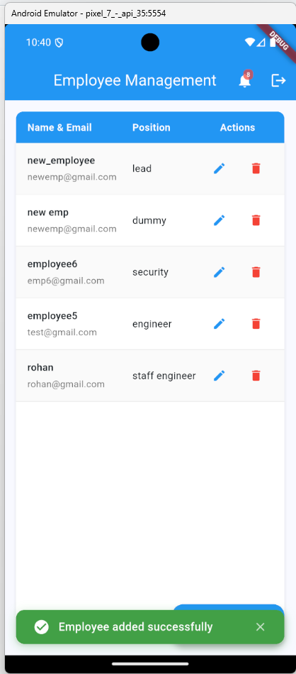
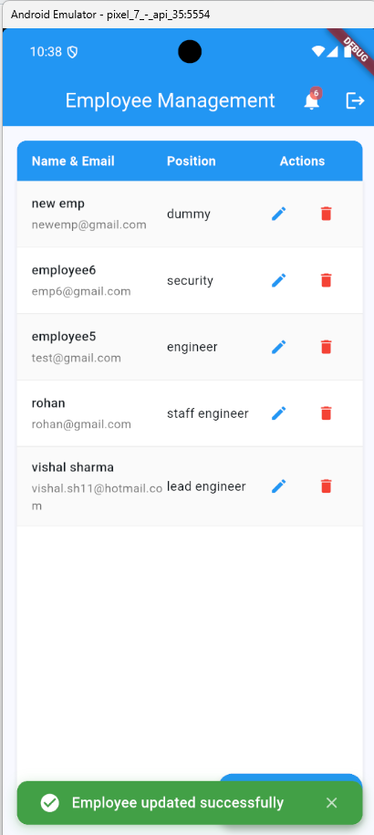
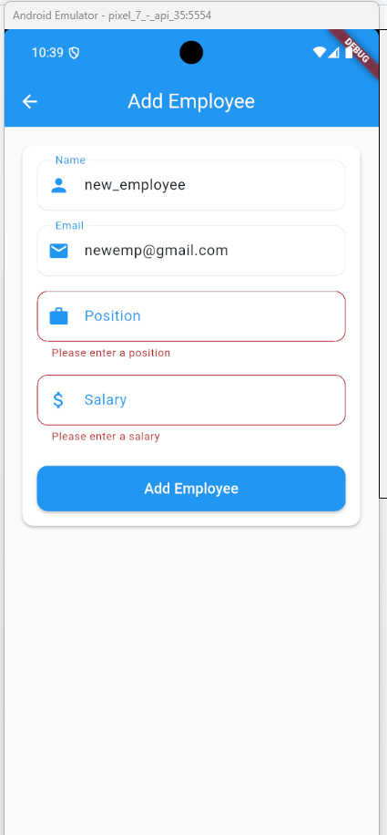

Slide 20
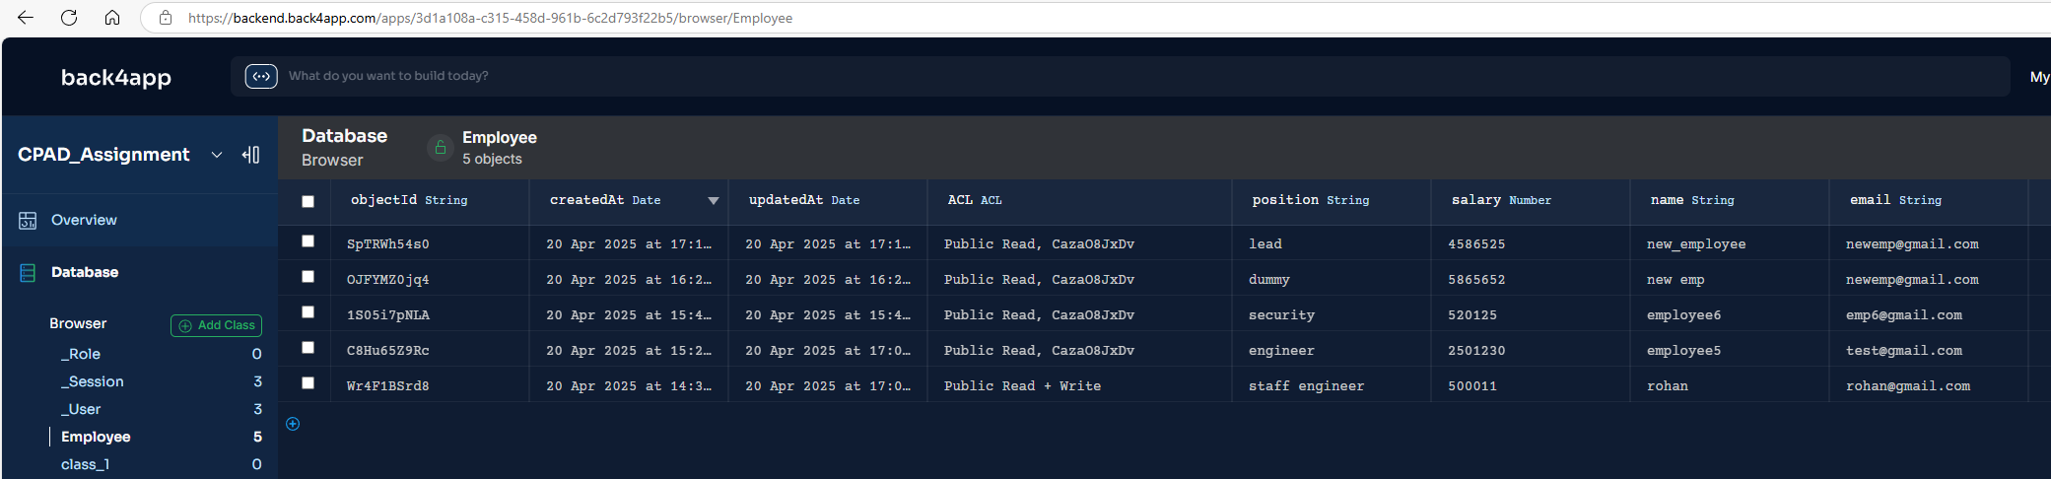
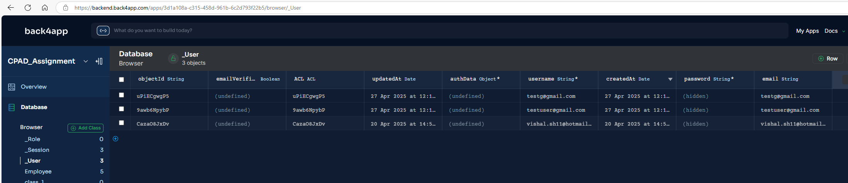

Slide 21
Architecture

Slide 22
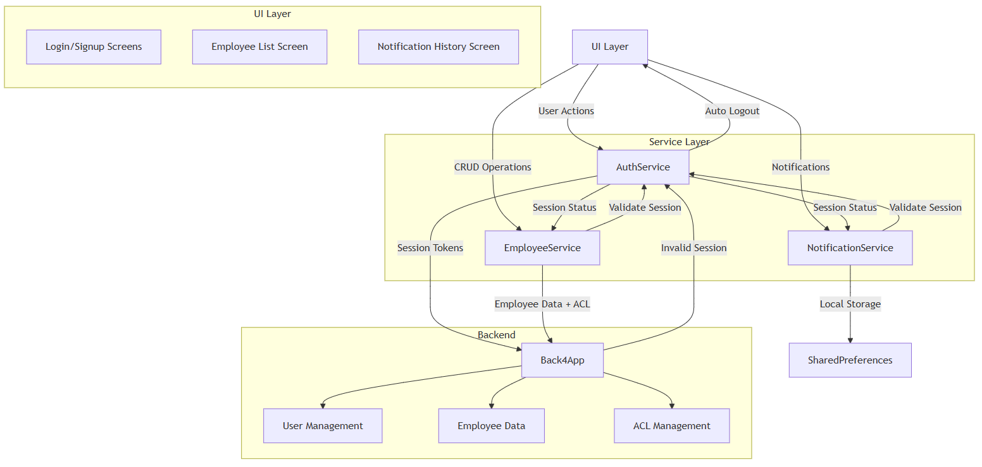

Slide 23
Learning Outcomes

Slide 24
Gained experience with Flutter’s widget tree and state management.
Learned to integrate backend services with Parse Server.
Improved skills in designing responsive and adaptive UI.
Leant low-code development with back4app framework

Slide 25
Thank you
Vishal Sharma
ID: 2023TM93550
2023tm93550@wilp.bits-Pilani.ac.in

